Slide 1
Operating Systems
Introduction to Operating System (OS)

Slide 2
What is an Operating System (1)?
A modern computer consists of:
One or more processors
Main memory
Disks
Printers
Various input/output devices.
Managing all these varied components requires a layer of software – the Operating System (OS).

Slide 3
What is an Operating System (2)?
An Operating System is a program that acts as an intermediary/interface between a user of a computer and the computer hardware.
OS goals:
Control/execute user/application programs.
Make the computer system convenient to use.
Ease the solving of user problems.
Use the computer hardware in an efficient manner.

Slide 4
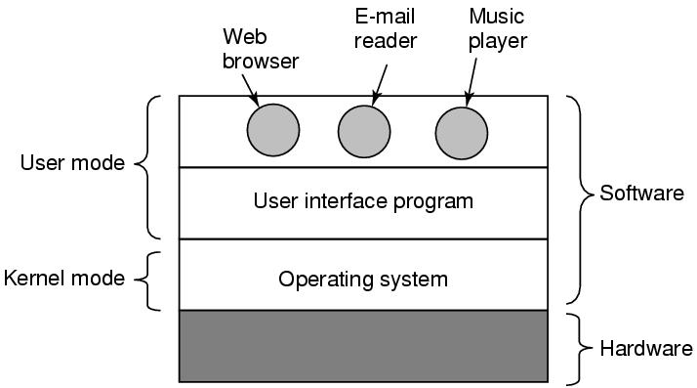
Where does the OS fit in?

Slide 5
Services provided by an OS
Facilities for program creation
editors, compilers, linkers, debuggers, etc.
Program execution
loading in memory, I/O and file initialization.
Access to I/O and files
deals with the specifics of I/O and file formats.
System access
resolves conflicts for resource contention.
protection in access to resources and data.

Slide 6
Why are Operating Systems Important?
Important to understand and know how to correctly use when writing user applications.
Large and complex systems that have a high economic impact and result in interesting problems of management.
Few actually involved in OS design and implementation but nevertheless many general techniques to be learned and applied.
Combines concepts from many other areas of Computer Science: Architecture, Languages, Data Structures, Algorithms, etc.

Slide 7
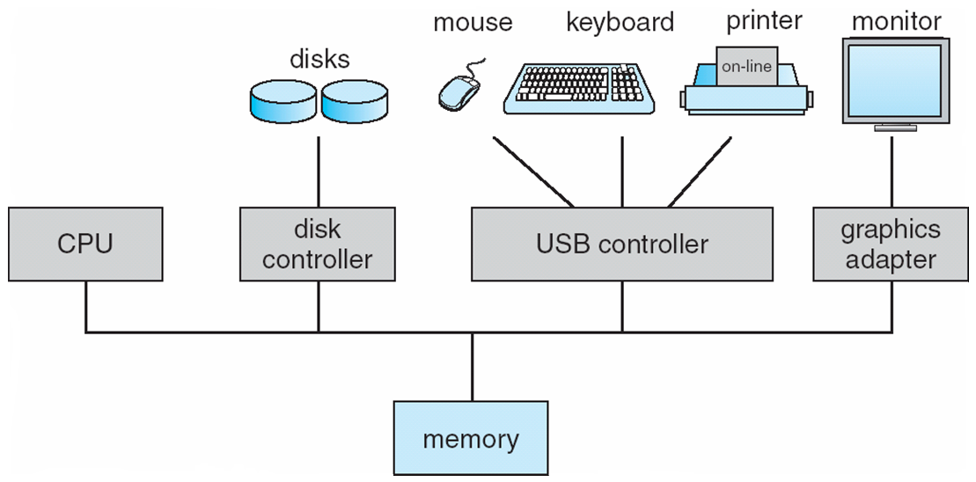
Computer Hardware Organization

Slide 8
Computer System Components
Hardware – provides basic computing resources (CPU, Memory, I/O devices, Communication).
Operating System – controls and coordinates use of the hardware among various application programs for various users.
System & Application Programs – ways in which the system resources are used to solve computing problems of the users (Word processors, Compilers, Web browsers, Database systems, Video games).
Users – (People, Machines, other computers).

Slide 9
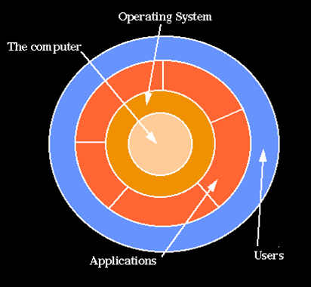
Hierarchical view of computer system

Slide 10
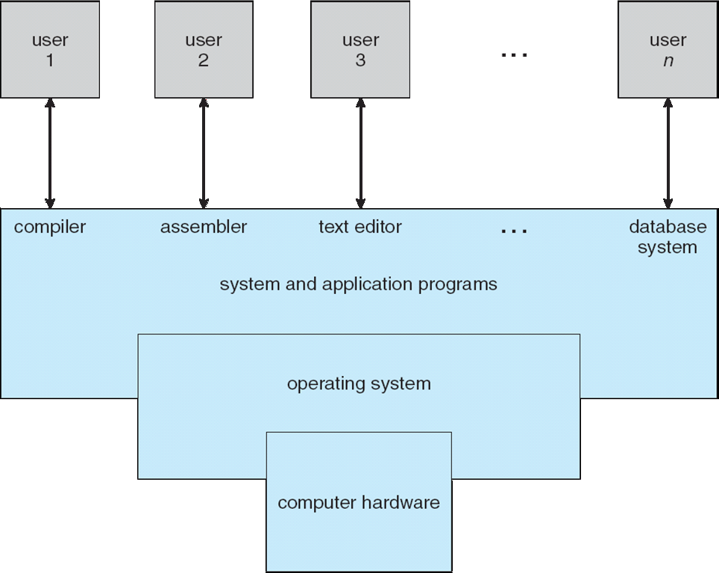
Static View of System Components

Slide 11
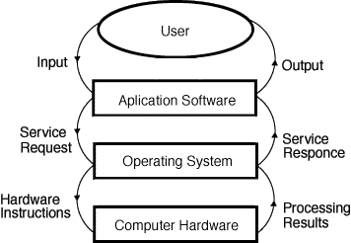
Dynamic View of System Components

Slide 12
Layers of a Computer System
End
User
Programmer
Application
Programs
Utilities
Operating-
System
Designer
Operating-System
Computer Hardware

Slide 13
What Operating Systems Do
Depends on the point of view.
Users want convenience, ease of use and good performance
Don’t care about resource utilization.
But a shared computer such as mainframe or minicomputer must keep all users happy.
Users of dedicate systems such as workstations have dedicated resources but frequently use shared resources from servers.
Handheld computers are resource poor, optimized for usability and battery life.
Some computers have little or no user interface, such as embedded computers in devices and automobiles.

Slide 14
Views of an Operating System
There are three classical views (in literature):
Resource Manager – manages and allocates resources.
Control program – controls the execution of user programs and operations of I/O devices.
Command Executer – Provides an environment for running user commands.
But one more modern view: the Operating System as a Virtual Machine.

Slide 15
1. Resource Manager
Resource Manager:
Manages and protects multiple computer resources: CPU, Processes, Internal/External memory, Tasks, Applications, Users, Communication channels, etc…
Handles and allocates resources to multiple users or multiple programs running at the same time and space (e.g., processor time, memory, I/O devices).
Decides between conflicting requests for efficient and fair resource use (e.g., maximize throughput, minimize response time).
Sort of a bottom-up view.

Slide 16
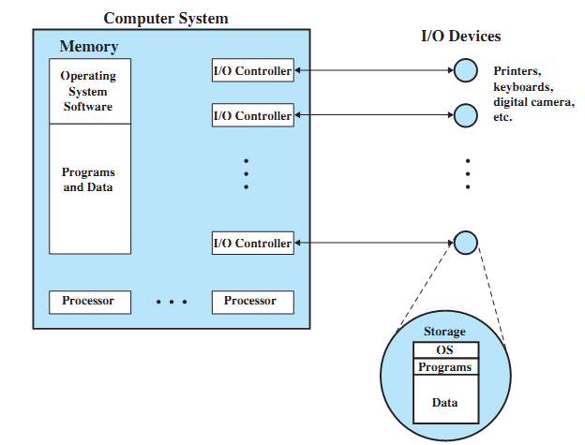
OS as a Resource Manager

Slide 17
Resource Manager oriented OS names
DEC RSX – Resource Sharing eXecutive
MIT Multics – MULTiplexed Information and Computing Services
IBM MFT/MVT – Multiple Fixed/Variable Tasks
IBM MVS – Multiple Virtual Storage
DEC VMS – Virtual Memory System
MVS TSO – Time Sharing Option
CTSS – Compatible Time Sharing System
IBM VM – Virtual machine

Slide 18
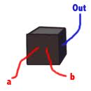
2. Control Program
Control Program:
Manages all the components of a complex computer system in an integrated manner.
Controls the execution of user programs and I/O devices to prevent errors and improper use of computer resources.
Looks over and protects the computer: Monitor, Supervisor, Executive, Controller, Master, Coordinator ….
Sort of a black box view.

Slide 19
Control program oriented OS names
Unisys MCP – Master Control Program
DR CP/M – Control Program/Microcomputer
IBM VM/CP – VM Control Program
IBM AIX – Advanced Interactive eXecutive
DEC RSX – Resource Sharing eXecutive

Slide 20
3. Command Executer
Command Executer:
Interfaces between the users and machine.
Supplies services/utilities to users.
Provides the users with a convenient CLI (Command Language Interface), also called a Shell (in UNIX), for entering the user commands.
Sort of a top-down view.

Slide 21
Command Executer oriented OS names
IBM AIX – Advanced Interactive Executive
IBM VM/CMS – Conversational monitor System

Slide 22
Modern view: Virtual Machine (1)
Operating System as a Virtual Machine:
An interface between the user and hardware that hides the details of the hardware (e.g., I/O).
Constructs higher-level (virtual) resources out of lower-level (physical) resources (e.g., files).
Definition: OS is a collection of software enhancements, executed on the bare hardware, culminating in a high-level virtual machine that serves as an advanced programming environment.
virtual machine = software enhancement = extended machine = abstract machine = layer = level = ring.

Slide 23
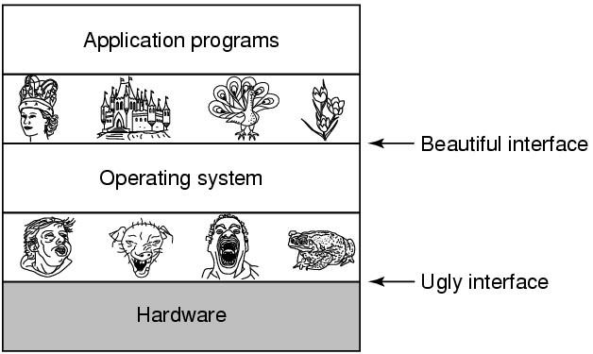
Modern view: Virtual Machine (2)

Slide 24
Definition of Operating System
There is no universally accepted definition.
“Everything a vendor ships when you order an operating system” is good approximation but varies widely.
“The one program running at all times on the computer” is the Kernel.
Everything else is either a system program (ships with the operating system) or an application program.

